Slide 1
Lecture 8
Building OLAP cube

Slide 2
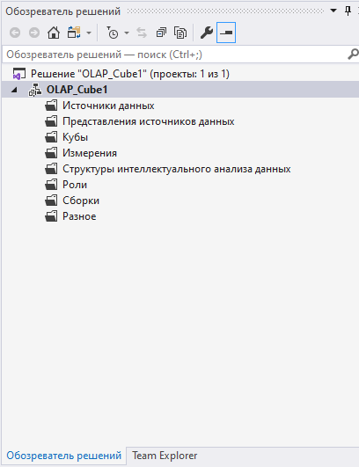
Adding a data source to the project
In Visual Studio we are required to create a new Analysis services project

Slide 3
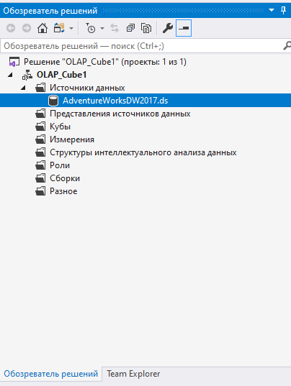
Adding a data source to the project
Then we add a new data source to the project

Slide 4
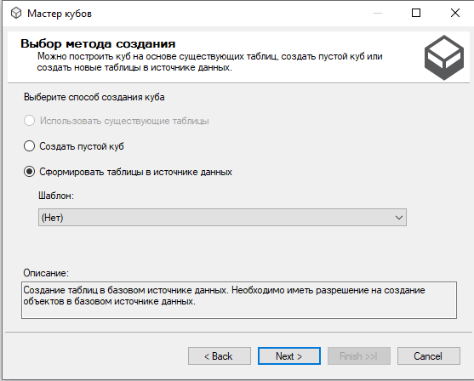
Creating a cube
Right click on the Cube folder and choose “A new cube”
Form tables from the data source

Slide 5
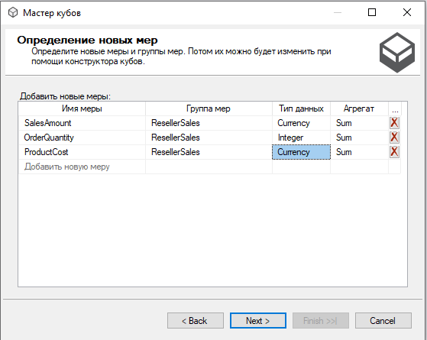
Adding new measures

Slide 6
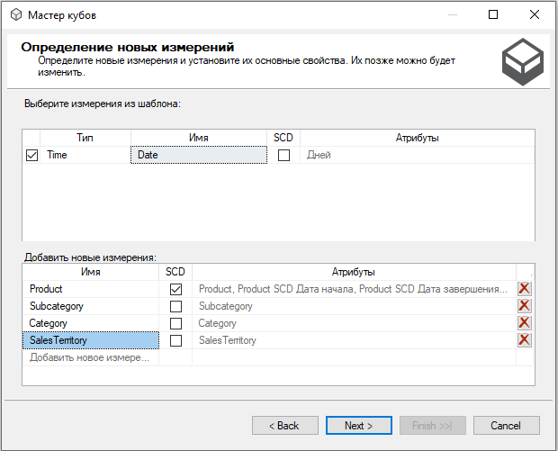
Adding new dimensions

Slide 7
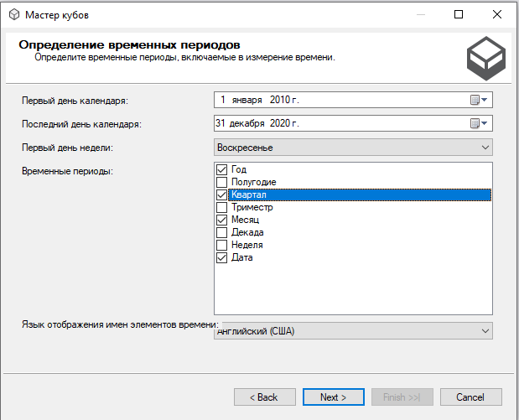
Time dimension

Slide 8
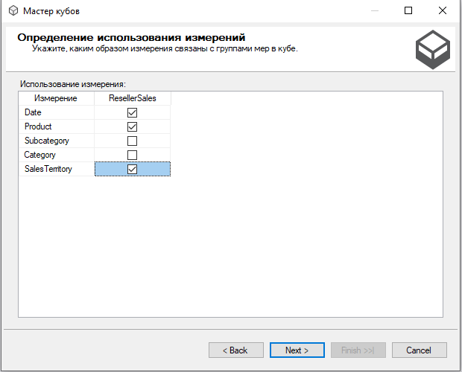
Cube dimensions
Choose several dimensions that will be reflected

Slide 9
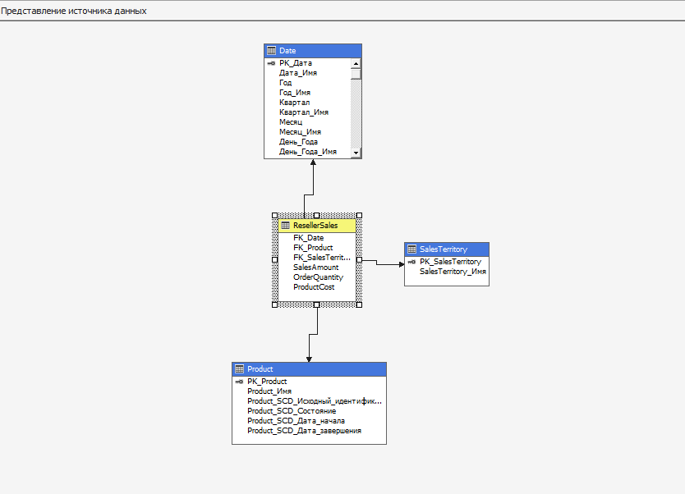
OLAP CUBE
Finalize the creation of Cube

Slide 10
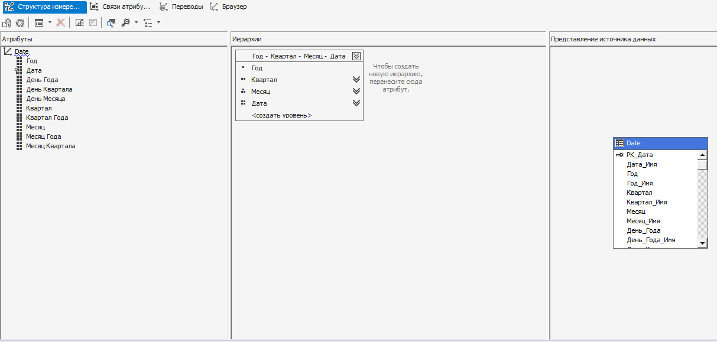
Adding new Attributes

Slide 11
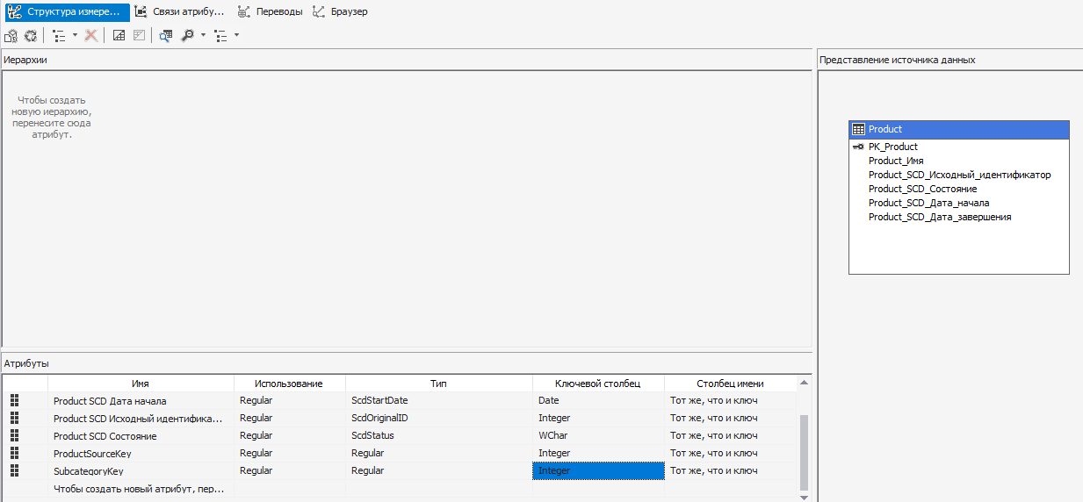
Adding new Attributes

Slide 12
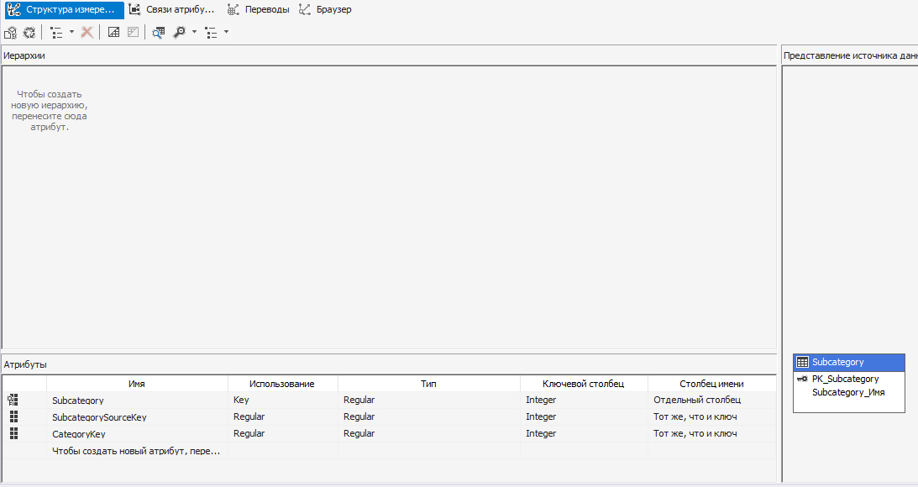
Adding new Attributes

Slide 13
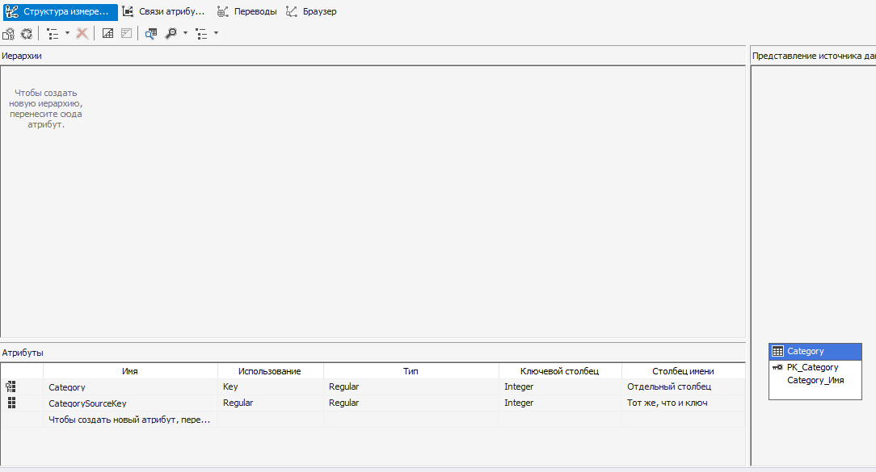
Adding new Attributes

Slide 14
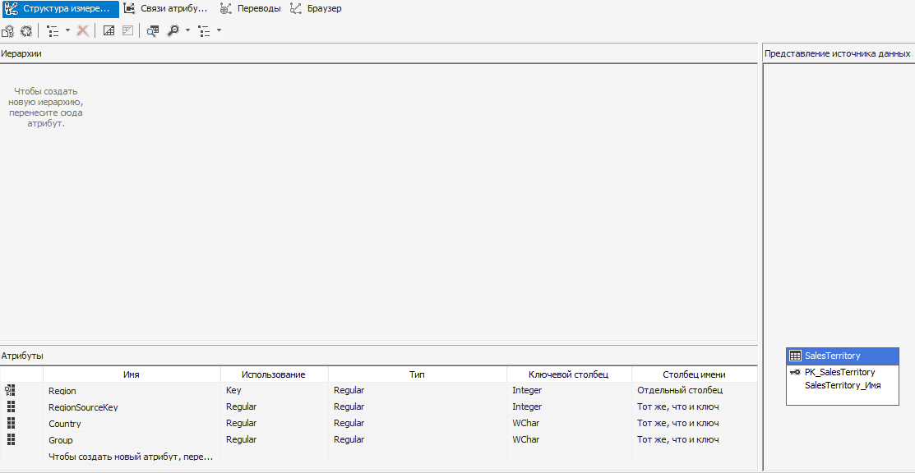
Adding new Attributes

